Slide 1

Exploratory Data Analysis
G2M insight for Cab Investment firm
Name: Ines Perko
Location: Germany
Team: LISP01
14.5.2021

Slide 2
Agenda
-A private firm in the US wants to invest in the cab industry. The task is to help them decide between two different cab companies.
-Approach:
-understanding the data
-EDA
-model training
-conclusion

Slide 3
Understanding the data:
The given dataset consists of 4 .csv files: Cab_Data, City, Customer_ID, Transaction_ID.
The number of total data points is: 355,032 and 12 attributes.
The first approach is to prepare datasets with processes such as searching for NA values and removing duplicates. After that, data should be merged into one file. There are no NA values or duplicates.
Timeframe of the data is from 31.01.2016 to 29.01.2019.

Slide 4
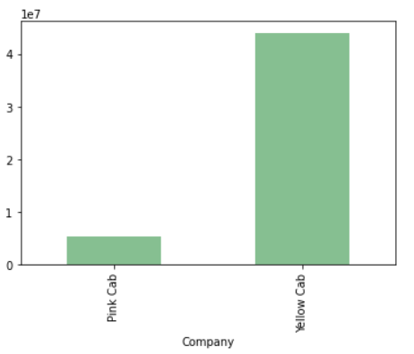
Analysis:
The next step is profit analysis. Profit of rides are calculated keeping other factors constant and only Price Charged and Cost of Trip features used to calculate profit.
The Yellow Cab company has higher total profit than the Pink Cab company. The profit is 88% higher than the Pink Cab’s profit.
Company | Total Profit
Pink Cab | 5307328
Yellow Cab | 44020373

Slide 5
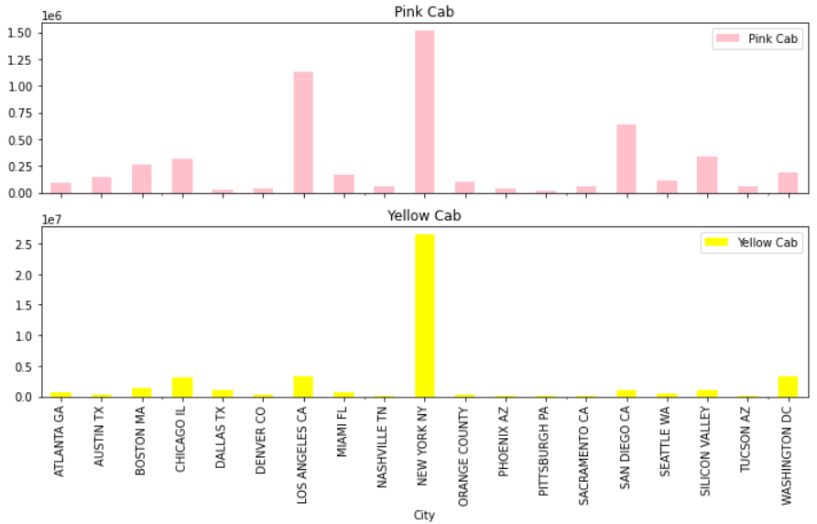
The highest profit in the both companies is in New York, with 1511474 dollars for the Pink Company and 26451080 dollars for the Yellow company. Other than that, it is worth mentioning Los Angeles for the Pink Company with 1125732 dollars profit. The Yellow Cab Company has 274681 rides in total and the Pink Cab Company has 84711.

Slide 6
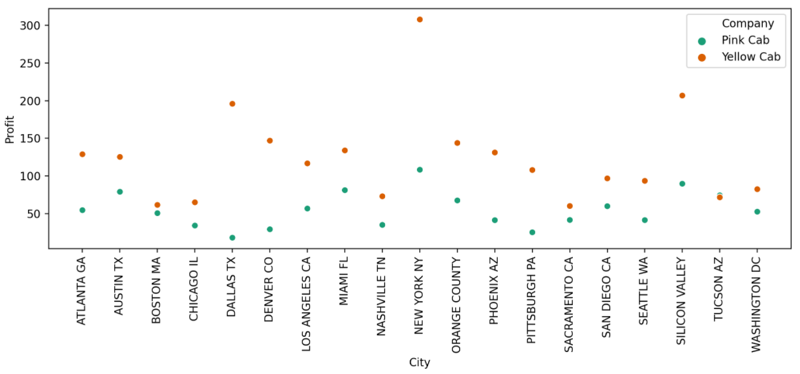
Average profit per ride (Total profit / number of rides) in the Pink Cab Company is 62.65, and in the yellow company is 160.26.
Average profit per ride in the cities: the max value is in New York for the Yellow Cab company (307.86 dollars profit), and the min value is in Dallas for the Pink Cab Company (17.92 dollars profit).

Slide 7
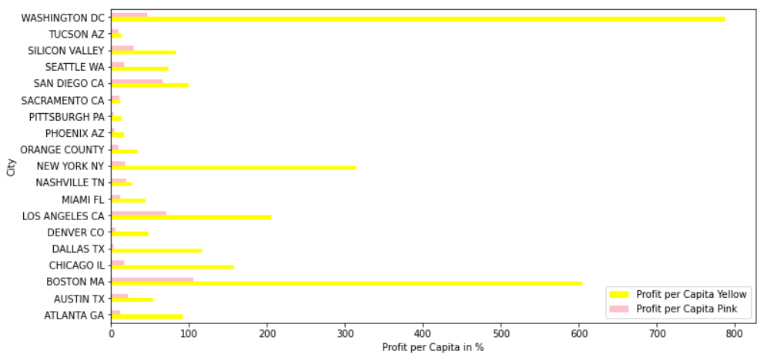
Washington, New York, and Boston have the highest number of profits per capita for the Yellow Cab Company. The Yellow Cab Company dominates the cab market in the mentioned cities.

Slide 8
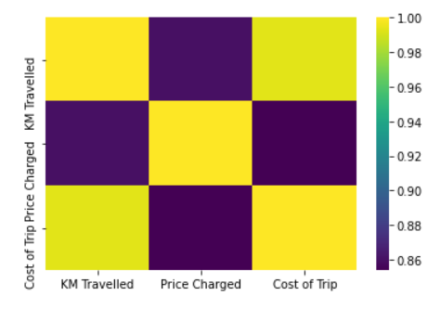
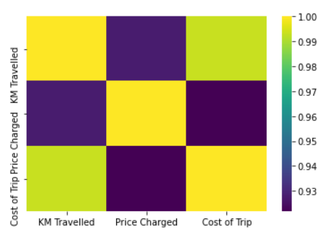
To find the correlation, the numerical values are used. For both companies, KM Travelled and Cost of Trip is correlated more than KM Travelled and Price Charged. The left graph is for the Yellow Cab Company and the right graph is for the Pink Cab Company.

Slide 9
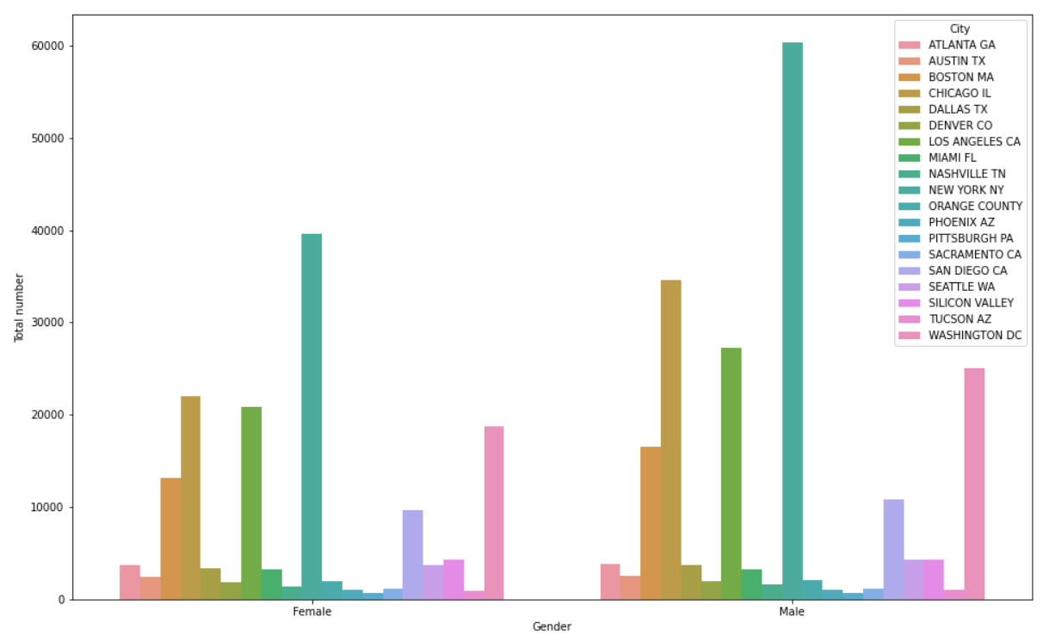
Most male and female users are in the NY city.

Slide 10
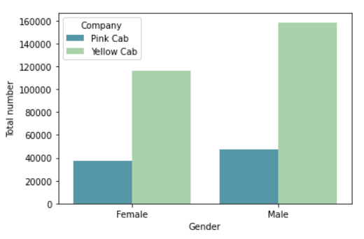
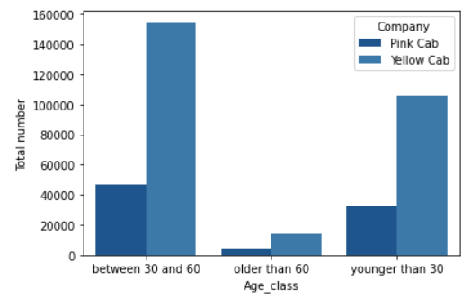
There are more users, both male and female, in the Yellow Cab Company. Particularly users aged between 30 and 60. The smallest age group of users is older than 60.

Slide 11
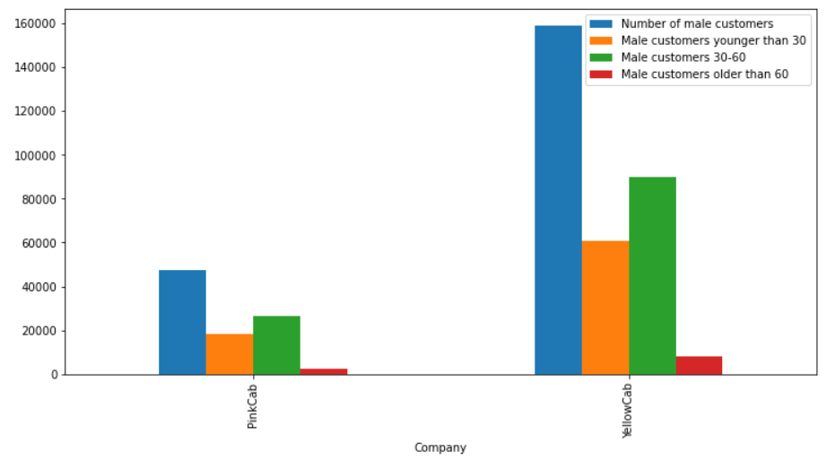
The highest number of male customers is aged between 30 and 60.

Slide 12
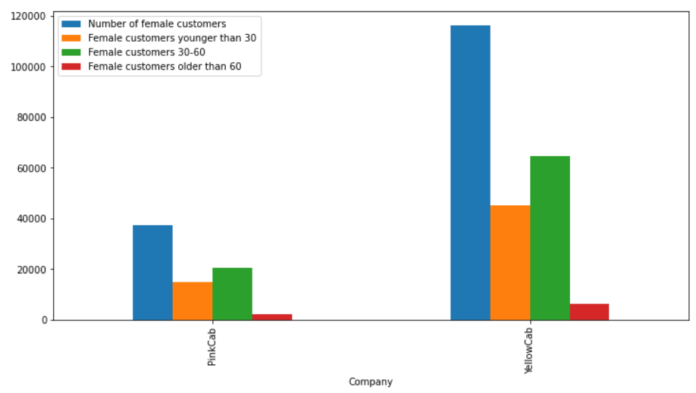
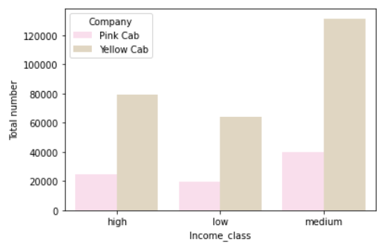
High and middle-class use cabs the most. The highest number of female customers are also aged between 30 and 60.

Slide 13
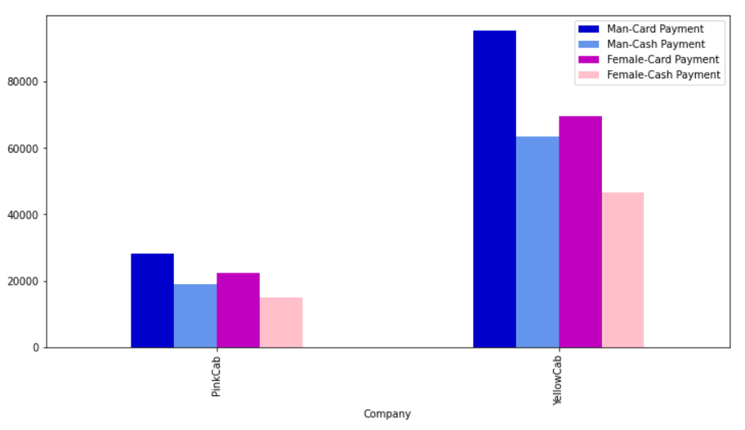
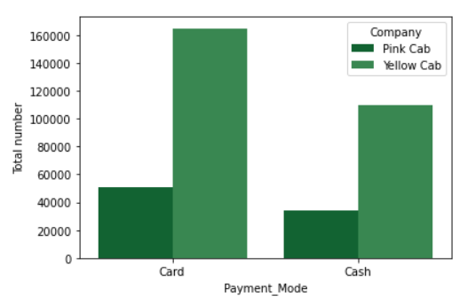
The most used payment method is card payment, with both men and women.

Slide 14
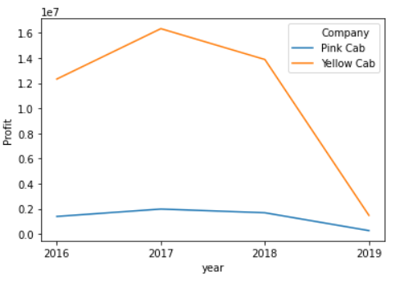
The Pink Cab Company has a stable, constant profit during years, while The Yellow Cab Company’s profit is more volatile and decreases during years.

Slide 15
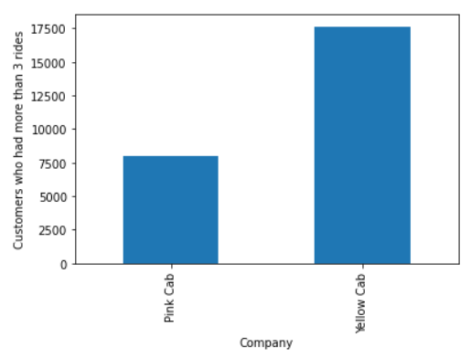
A company that has more regular customers, i.e., customers that took more than 3 rides is The Yellow Cab Company.

Slide 16
Conclusion:
Based on the analysis done above, the following recommendations are made to decide between companies:
-The Yellow Cab Company has higher profit in all aspects (total profit, profit in cities, profit per capita and average profit per ride).
-The Yellow Cab Company has a higher number of rides.
-In general, more cab users live in bigger cities, they are aged between 30-60, for both male and female users. The high and middle-class use cabs the most. Even in this general analysis, the Yellow Cab Company has more users.
-Even though the Pink Cab Company has a more stable profit during years, and the Yellow Cab Company’s profit decreased, my recommendation is still to invest in the Yellow Cab Company since it still has higher profit and more users use it, therefore its business is well established.

Slide 17
Thank You

